Slide 1
A Fresh Perspective from the FDA on the Final IND Safety Reporting Rule

Slide 2
Meet Today’s Speakers
Robert Temple, MD
Deputy Director, CDER
Jacqueline Corrigan-Curay
Director, Office of Medical Policy
Steven Beales
SVP, Scientific and Regulatory, WCG

Slide 3
IND Safety Reporting:
A Systematic Approach to Safety
Jacqueline Corrigan-Curay, JD, MD
Director, Office of Medical Policy
CDER/FDA
June 9, 2021

Slide 4
Disclaimer
This talk reflects the views of the author and should not be construed to represent FDA’s views or policies.
The speaker has no relevant financial conflicts.
Notes:
Touches some legal stuff that I have to be careful with

Slide 5
Outline
Brief Overview of 2010 IND Safety Rule and follow-on guidance
Opportunities and challenges for aggregate safety analyses

Slide 6
Timeline of IND Safety Reporting Policy Development
Final Rule and Companion Draft Guidance Published
Companion Final Guidance Published
Proposed Rule Published
Follow-on Draft Guidance Published
Duke Margolis Public Workshop on Safety Assessment for IND Safety Reporting
September 2010
December 2012
December 2015
March 2018
March 2003

Slide 7
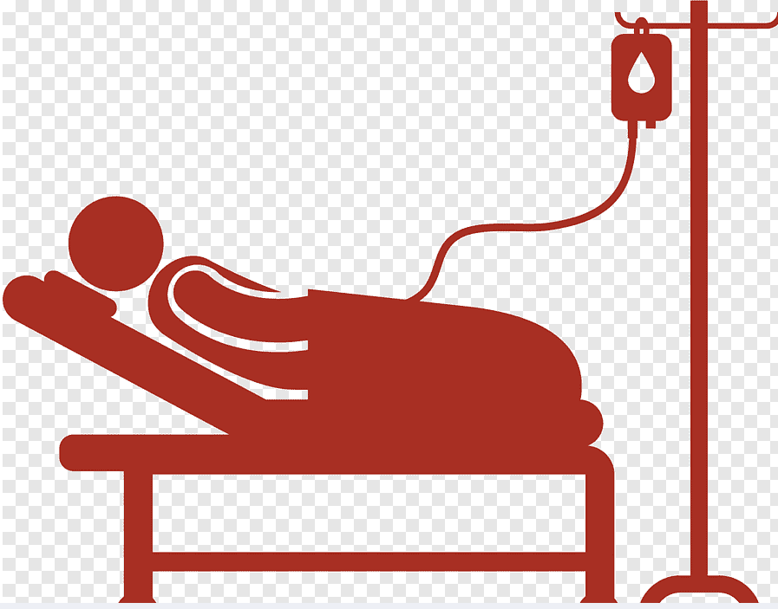

Types of IND Safety Reports
Individual Events
Aggregate Analysis
Events that are:
Uncommon and strongly associated with drug exposure (e.g., agranulocytosis Stevens Johnson Syndrome) (312.32(c)(1)(i)(A))
Not commonly associated with drug exposure but uncommon in population (e.g., tendon rupture) (312.32(c)(1)(i)(B))
Events/findings that:
Occur more frequently in drug treatment group than control (312.32(c)(1)(i)(C))
Occur at a clinically important increased rate above that listed in protocol or IB (312.32(c)(1)(iv))
Are identified in epidemiological studies, or pooled analysis of multiple studies, that suggest a significant risk (312.32(c)(1)(ii))

Slide 8
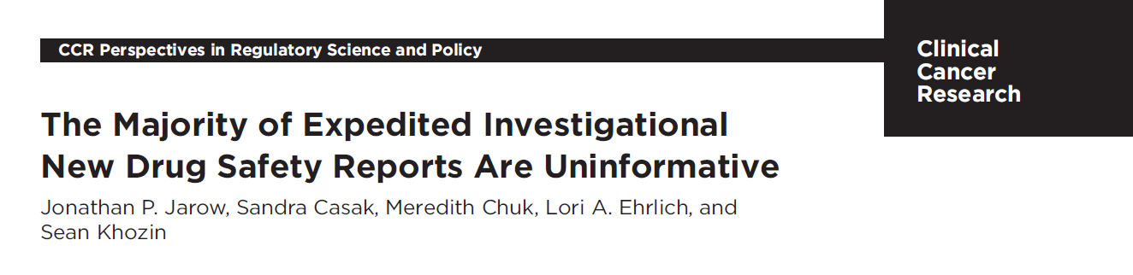
A Major Goal of the New Regulation was to Address Overreporting
In a published published study by Jarow, et al of 160 expedited cancer IND Safety reports between 2006 and:
54% were expedited reports of expected adverse events listed in product labeling or the Investigator Brochure
The sponsor did not conclude that the reported adverse event was suspected in 50% of cases
Of 38 reports that were serious, unexpected, suspected, 42% were anticipated adverse events in the population
Therefore of 160 reports, 22 (14%) were informative – serious, unexpected suspected adverse events

Slide 9
IND Safety Guidance Development 2015 : Addressing Aggregate Analyses
Obvious drug-related events are uncommon and easier to identify but identifying suspected adverse reactions based on aggregate data is much more challenging
2015 draft guidance Safety Assessment for IND Safety Reporting was developed to facilitate evaluation of events requiring aggregate analyses
The 2015 draft guidance provides recommendations on:
Planned unblinding of safety data to assess for aggregate safety signals
Encouraged creation of a safety assessment committee (SAC), defined potential composition and role to analyze the aggregate data
Aggregate analyses for comparison of adverse event (AE) rates across treatment groups
Pooling data across studies
Assessing whether criteria met for IND safety reporting
Development of a safety surveillance plan and recommendation to submit to the IND

Slide 10
Putting Aggregate Reporting into Perspective
IND safety reporting process requires thoughtful multidisciplinary (e.g., scientific, statistical, and medical) approach – clinical judgement is key
Aggregate review of anticipated events may be more likely to detect an imbalance when drug development programs have sufficient data and enrolled subjects (e.g., late-stage)
More challenging to make meaningful comparisons of event numbers or to identify clinically important increase in event rate in small programs
Aggregate analyses may be most useful in evaluating an increased rate of relatively common events, such as stroke or heart attack in an elderly population
Tailor approach to disease and types of events, and more than one approach plausible

Slide 11
Unblinding of Safety Data and Implications for Trial Integrity
The 2015 draft guidance recommends:
Preferred approach: regular unblinded comparisons of rates of serious adverse events (SAEs) that are not study endpoints and are only interpretable in the aggregate
Examples:
events anticipated to occur in the study population
expected serious adverse reactions
Alternative approach: establish an overall rate for the treatment groups for a specific SAE and only unblind if substantially higher than predicted (“trigger approach”)
“because of the substantial challenges of specifying a predicted rate for all events, preferred approach is to regularly perform unblinded comparisons”

Slide 12
Unanticipated Problems and IND Safety Reports
FDA’s Guidance for Clinical Investigators, Sponsors, and IRBs: Adverse Event Reporting to IRBs - Improving Human Subject Protection (2009)
In general, an AE observed during the conduct of the study should be considered an unanticipated problem involving risk to human subjects, and reported to the IRB
if it were unexpected, serious, and would have implications for the study of the conduct (i.e., requiring a significant, and usually safety-related, change in the protocol such as revising inclusion/exclusion criteria or including a new monitoring requirement, informed consent, or investigator’s brochure).
In summary, FDA believes that only the following AEs should be considered as unanticipated problems that must be reported to the IRB
Single occurrence :
Of a serious, unexpected event that is uncommon and strongly associated with drug exposure, e.g. angioedema, Steven’s Johnson syndrome
Or more often a small number of occurrences, of a serious, unexpected event that is not commonly associated with drug exposure, but uncommon in the study population (e.g. tendon rupture)
Multiple occurrences of an AE that, based on an aggregate analysis, is determined to be an unanticipated problem (e.g., a comparison of rates across treatment groups reveals higher rate in the drug treatment arm versus a control)
An AE that is described or addressed in the investigator’s brochure, protocol, or informed consent documents, but occurs at a specificity or severity that is inconsistent with prior observations
A serious AE that is described or addressed in the investigator’s brochure, protocol, or informed consent documents, but for which the rate of occurrence in the study represents a clinically significant increase in the expected rate of occurrence
Any other AE or safety finding (e.g., based on animal or epidemiologic data) that would cause the sponsor to modify the investigator’s brochure, study protocol, or informed consent documents

Slide 13
Guidance on Conduct of Clinical Trials for Medical Products during COVID-19 Public Health Emergency (2020)
Q. 25 If an investigator receives an IND safety report from a sponsor, is it acceptable to review only reports that the sponsor indicates will result in a change to the investigator brochure, informed consent, or protocol? Which IND safety reports must an investigator send to the IRB?
No, it is not acceptable for an investigator to review only certain IND safety reports.
Under 21 CFR 312.60, investigators are responsible for protecting the safety of trial participants in a clinical investigation.
IND safety reports must be sent by the sponsor to FDA and all participating investigators when the sponsor determines that a serious adverse event is unexpected and there is a reasonable possibility that the drug caused the serious adverse event, i.e., there is evidence to suggest a causal relationship between the drug and the adverse event.
Reviewing IND safety reports is essential for protecting the safety of trial participants because a serious and unexpected adverse event represents a new potential risk associated with the investigational product.
FDA considers the review of all IND safety reports critical to fulfilling investigators’ responsibility to protect the safety of trial participants in a clinical investigation
FDA considers a serious and unexpected adverse event that meets the criteria for sponsor reporting to FDA and all investigators in an IND safety report under 21 CFR 312.32 . . . To be an “unanticipated problem involving risk to human subjects or others and therefore must be reported to the IRB by the investigator

Slide 14
Panel Q&A

Slide 15
Over-reporting
Why do the FDA, investigators and IRBs continue to receive large numbers of uninformative safety reports that do not comply with the final rule for IND safety reporting?
Is it acceptable for a site to have a policy stating we will only acknowledge reports from Sponsor that are Unanticipated Problems, will lead to a protocol change and require forwarding to IRB?
What are the regulatory consequences for sponsors who continue to report serious adverse events that are clearly unrelated, manifestations of the underlying disease that commonly occur in the study population or are study endpoints?
What can be done to mitigate sponsor's concern about non-compliance that may lead to over-reporting of SUSARs?
If a Sponsor requires SUSARs to be reviewed and saved onsite, but the site refuses per their policy, what are the implications?

Slide 16
Harmonization
What is the FDA doing to harmonize its scientifically optimal IND safety reporting approach with the more conservative over-reporting approaches adopted by other countries?
Is it possible to report a SUSAR to more conservative (and less scientific) agencies and not report to FDA for the same case?
Can you compare ICH-E6 ADR phrase “reasonable possibility cannot be ruled out” with 312.32(a) “evidence to suggest a causal relationship? Are they the same standard?

Slide 17
Committees
How can Safety Assessment Committees resolve some of the current problems that sponsors face with complying with the final rule?

Slide 18
Questions From the Audience?

Slide 19
Thank you!

